Slide 1
2011-Present
Team 1

Slide 2
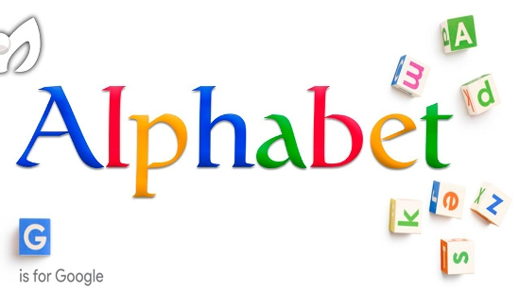
Sergey Brin and Larry Page
Co-founders of Google
2011 - Page stepped up as CEO, Brin stepped down as president
2015 - cofounded Alphabet Inc.
American Multi-Industry Company
Parent company of google
Brin stepped up as President

Slide 3
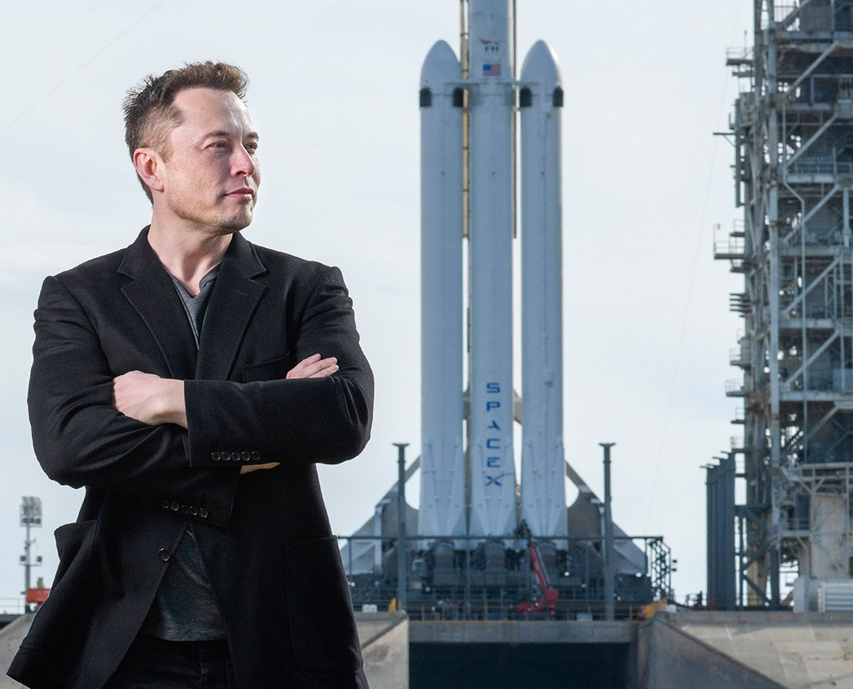
Elon Musk
Transferred from Queens U (Canada) -> U Penn
Bachelors in Economics and Physics
Dropped PhD program at Stanford to join Internet Boom
2018- SpaceX Internet Satellites
More accessible service in rural areas
Co-chair of OpenAI
Works on Artificial General
Intelligence (AGI)
Notes:
Elon Musk only attended stanford for 2 days
Internet Boom or dotcom bubble started in 1995 and crashed in 2002

Slide 4
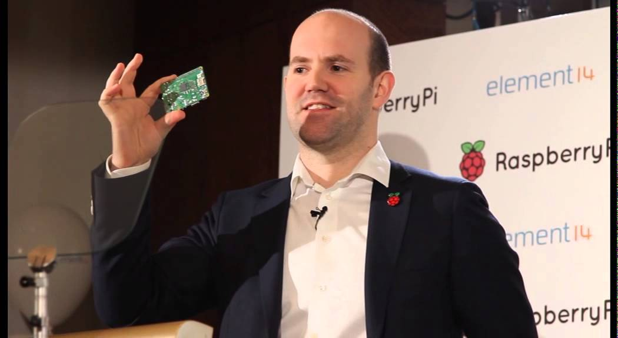
Eben Upton
BA in Physics and Engineering from Cambridge (1999)
Diploma in Computer Science (2001)
PhD in Philosophy and an MBA
Director of Studies in CS: St John’s College, Cambridge
Visiting researcher at Intel, founder of IdeaWorks3D, and software engineer at IBM
2012 - CEO of Raspberry Pi
Foundation in UK

Slide 5
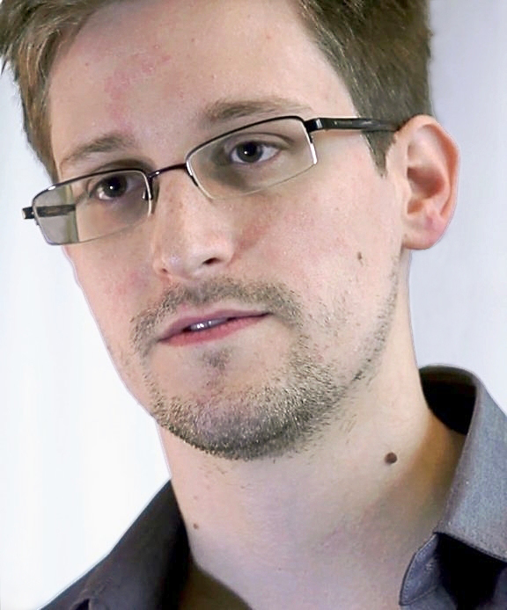
Edward Snowden
Studied computers at Maryland (‘99-’01 & ‘04-’05)
Worked for both the CIA and NSA
2013- charged for leaking top secret info
Many security regulations today for government (OPSEC)
Notes:
CC is community college

Slide 6
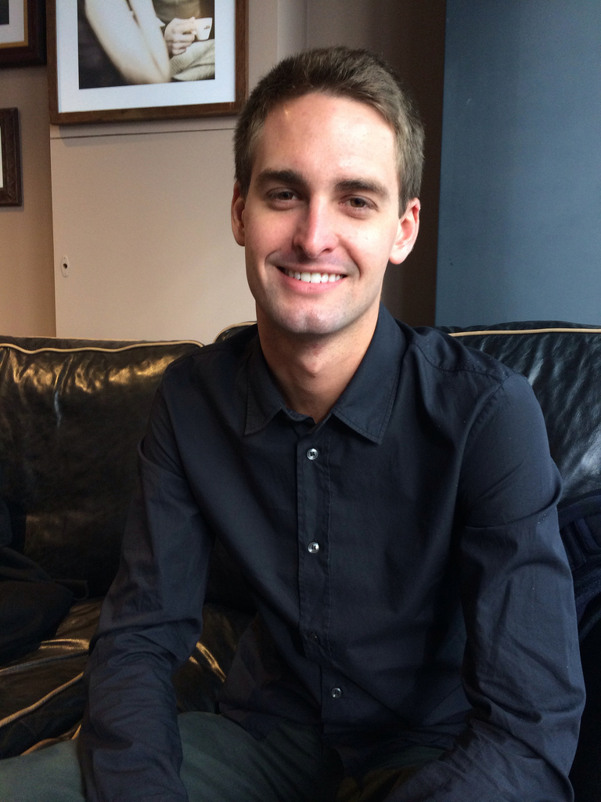
Evan Spiegel
Studied at Arts College Center of Design
Studied Product Design at Stanford
2011- worked with Bobby Murphy and Reggie Brown to create ‘picaboo’, later named Snapchat
2015- named youngest billionaire in the world

Slide 7
2011
Chromebooks with Chrome OS
Netflix Video Streaming (Cloud streaming)
Twitch
Siri & Gesture interfaces
Social network expansion
Li-Fi (~40Gb/s at 2.5m)
Notes:
Blockbuster filed for bankrupcy in 2010 anc could have bought netflix for $50M in 2000

Slide 8
2011
Graphene
Smart transformers
Solid-state batteries
Homomorphic encryption
Crash-proof microkernel code
Software Defined Networking
Notes:
Blockbuster filed for bankrupcy in 2010 anc could have bought netflix for $50M in 2000

Slide 9
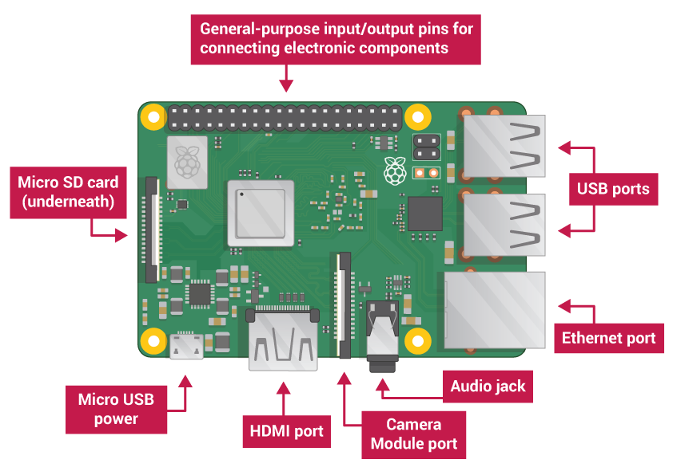
2012
Vine founded
Pinterest made available
Raspberry Pi Released
Google Play and Drive

Slide 10
2012
Megaupload Crackdown
3d transistors
Intel vs Amd Battle
Cisco rejects SDNs and Openflow

Slide 11
2013
React JavaScript (UI Building)
ChromeCast
Google Glass and smart watches
Patreon

Slide 12
2013
Big data on cheap phones
Intel quark
Self-destructing messages
Additive manufacturing

Slide 13
2014
Swift
Babel (created js backwards compatibility)
Yoshitomo Imura imprisoned for 3D-printed gun
Agricultural Drones
DARPA’s ARGUS-IS streams 1EB/day
XP support ended (8 April)

Slide 14
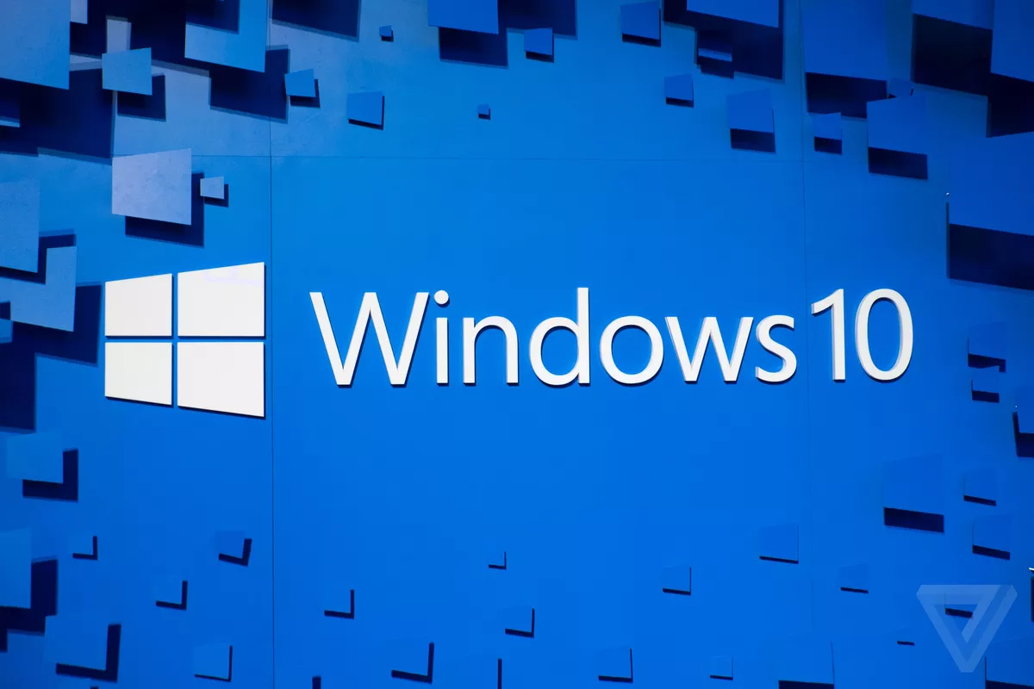
2015
Windows 10 Released
React Native
Ukrainian power plant attack

Slide 15
2016
Cyber Security Attacks
Dropbox, Yahoo, Dyn
Norse created
Apple discontinues headphone jack
introducing AirPods
Google Assistant
10-series GTX Cards

Slide 16
2017
Reinforcement Learning - AlphaGo
Reversing Paralysis
Using brain implants to restore movement
MS finally fixes their protocol exploits
Carbon nanotube CPUs
3D memory integration
Xbox controllers on pc

Slide 17
2018
Q code
3D metal printing
Artificial embryos
Consumer AIs
Meltdown and Spectre (Speculative Execution)
Government System Backdoor movement

Slide 18
2019
Commercial Quantum Computing by IBM
7nm GPUs
5G Networking?
PCI-e 4?
Close to finding the first SHA256 collision
Next-gen M.2

Slide 19
Summary

Slide 20
Sources
https://www.computerhope.com/history/
https://www.computerhistory.org/timeline/2011/
https://www.computerhope.com/history/2011.htm
https://www.computerhope.com/history/2000today.htm
https://210geeks.com/blogs/news/the-latest-computer-technology-in-2016
https://www.technologyreview.com/lists/technologies/2017/
https://www.pcworld.com/article/3150700/computers/top-10-pc-technologies-and-trends-to-watch-in-2017.html
https://www.technologyreview.com/lists/technologies/2013/
https://www.keyideasinfotech.com/blog/impact-of-smartphone-on-society/
http://chromebooks.cps.edu/about-us.html
https://home.bt.com/tech-gadgets/computing/windows-7/windows-7-windows-10-compared-11364050061832

